Slide 1


PLANE AND SPHERICAL TRIGONOMETRY

Slide 2
TRIGONOMETRY
Derived from the Greek words “trigonon” which means triangle and “metron” which means to measure.
Branch of mathematics which deals with measurement of triangles (i.e., their sides and angles), or more specifically, with the indirect measurement of line segments and angles.

Slide 3
TRIANGLES
Definition: A triangle is a polygon with three sides and three interior angles. The sum of the interior angles of a triangle is 180⁰.
CLASSIFICATION OF TRIANGLES ACCORDING TO ANGLES:
Oblique triangle – a triangle with no right angle
– Acute triangle
– Obtuse triangle
Right triangle – a triangle with a right angle
Equiangular triangle – a triangle with equal angles

Slide 4
CLASSIFICATION OF TRIANGLES ACCORDING TO SIDES:
Scalene triangle – a triangle with no two sides equal
Isosceles triangle – a triangle with two sides equal
Equilateral triangle – a triangle with three equal sides

Slide 5
CLASSIFICATION OF ANGLES:
Zero angle – an angle of 0⁰
Acute angle – an angle between 0⁰ and 90⁰
Right angle – an angle of 90⁰
Obtuse angle – an angle between 90⁰ and 180⁰
Straight angle – an angle of 180⁰
Reflex angle – an angle between 180⁰ and 360⁰
Circular angle – an angle of 360⁰
Complex angle – an angle more than 360⁰

Slide 6
LESSON 1
ANGLE MEASURE

Slide 7
ANGLE
An angle is formed by rotating a given ray about its endpoint to some terminal position. The original ray is the initial side of the angle, and the second ray is the terminal side of the angle. The common endpoint is the vertex of the angle.
Angles formed by a counterclockwise rotation are considered positive angles, and angles formed by a clockwise rotation are considered negative angles.
An angle is said to be in standard position if its initial side is along the positive x-axis and its vertex is at the origin.
Two positive angles are complementary angles if the sum of the measures of the angles is 90⁰. Each angle is the complement of the other angle.
Two positive angles are supplementary angles if the sum of the measures of the angles is 180⁰. Each angle is the supplement of the other angle.

Slide 8
ANGLE MEASURE
The measure of an angle is determined by the amount of rotation of the initial side.
Units of measurements:
Degree
1/360 of a complete revolution
denoted by ⁰
Radian
measure of the central angle subtended by an arc whose length is equal to the radius of the circle
denoted by rad.

Slide 9
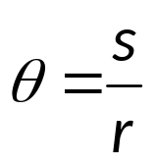
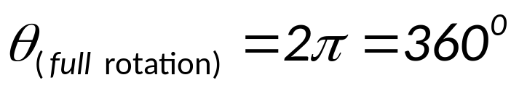
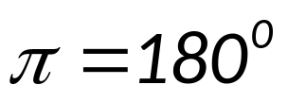
DEFINITION OF RADIAN MEASURE
Given an arc length s on a circle of radius r, the measure of the central angle subtended by the arc is radians.

Slide 10
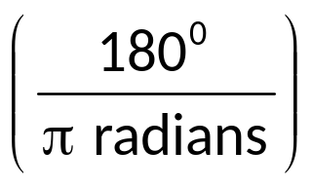
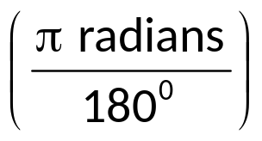
RADIAN – DEGREE CONVERSION
To convert from radians to degrees, multiply
by
To convert from degrees to radians, multiply
by

Slide 11
DEGREE – MINUTE – SECOND CONVERSION
degrees to minutes, multiply by (60’/1⁰)
minutes to degrees, multiply by (1⁰/60’)
degrees to seconds, multiply by (3600”/1⁰)
seconds to degrees, multiply by (1⁰/3600”)
minutes to seconds, multiply by (60”/1’)
seconds to minutes, multiply by (1’/60”)

Slide 12
COTERMINAL ANGLES – are angles in standard position having the same sides.
MEASURES OF COTERMINAL ANGLES
Given angle θ in standard position with measure x⁰, then the measures of the angles that are coterminal with angle θ are given by
x⁰ + k · 3600
where k is an integer.
Notes:
++

Slide 13
EXAMPLES
Find the measure (if possible) of the complement and the supplement of each angle.
a. 50⁰ b. 130⁰ c. 55⁰34’10”
Convert the degree measure to exact radian measure.
a. 30⁰ b. 225⁰ c. – 120⁰
Convert the radian measure to exact degree measure.
a. π/4 b. 2 radian c. – 5π/6
Use a calculator to convert each decimal degree measure to its equivalent DMS measure.
a. 18.96⁰
b. 224.282⁰

Slide 14
Use a calculator to convert each DMS measure to its equivalent degree measure.
a. 141⁰6’9”
b. 19⁰12’18”
6. Find the degree measure of the angle for each rotation and sketch each angle in standard position.
a. 2/3 couterclockwise rotation
b. 5/9 clockwise rotation

Slide 15

LENGTH OF A CIRCULAR ARC
Let r be the length of the radius of a circle and Ө be the non-negative radian measure of a central angle of the circle. Then the length of the arc s that subtends the central angle is s = rӨ.
where Ө is in radians
r
s

Slide 16

AREA OF A CIRCULAR SECTOR
Circular Sector – is a figure formed by two radii and an arc.
Area of circular sector is given by, A = ½ rs
but s = rӨ
so A = ½ r (rӨ)
thus, A = ½ r²Ө
where Ө is in radians
r
s

Slide 17
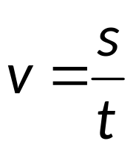
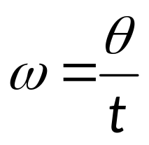
LINEAR AND ANGULAR SPEED
Definition of Linear and Angular Speed of a Point Moving on a Circular Path
A point moves on a circular path with radius r at a constant rate of Ө radians per unit of time t. Its linear speed is
where s is the distance the point travels, given by s = rӨ. The point’s angular speed is

Slide 18
THE LINEAR AND ANGULAR SPEED RELATIONSHIP
The linear speed v and the angular speed ω, in radians per unit time, of a point moving on a circular path with radius r are related by
v = r ω

Slide 19
EXAMPLES
Find the length of an arc that subtends a central angle 150⁰ in a circle with radius of 10 feet.
Big Ben, the famous clock tower in London, has a minute hand that is 15 feet long. How far does the tip of the minute hand travels in 40 minutes?
A pulley with radius of 10 in. uses a belt to drive a pulley with a radius of 6 in. Find the angle through which the smaller pulley turns as the 10-inch pulley makes one revolution.
Pittsburgh, Pennsylvania and Miami, Florida lie approximately on the same meridian. Pittsbugh has a latitude of 40.5⁰ N and Miami, 25.5⁰ N. Find the distance between these two cities. (The radius of the earth is 3960 miles)
An irrigation system uses a straight sprinkler pipe 300 ft. long that pivots around a central point. Due to an obstacle, the pipe is allowed to pivot through 280⁰ only. Find the area irrigated by the system.

Slide 20
The top and bottom ends of a windshield wiper blade are 34 in. and 14 in. from the pivot point, respectively. While in operation, the wiper sweeps through 135⁰ . Find the area swept by the blade.
A winch of radius 2 ft. is used to lift heavy loads. If the winch makes 8 revolutions every 15 sec, find the speed at which the load is rising.
Each tire on a truck has a radius of 18 inches. The tires are rotating at 500 revolutions per minute. Find the speed of the truck to the nearest mile per hour.
Two pulleys, one 6 in. and the other 2 ft. in diameter, are connected by a belt. The larger pulley revolves at the rate of 60 rpm. Find the linear velocity in ft/min and calculate the angular velocity of the smaller pulley in rad/min.

